Slide 1
NLP-AI
Java Lecture No. 10
Satish Dethe
<satishd@cse.iitb.ac.in>

Slide 2
Contents
Quick review of lecture 9
Problem 1
Problem 2
Problem 3
Problem 4
nlp-ai@cse.iitb

Slide 3

Object & Class ….
These objects have different colors, locations & sizes.
Do they belong to the same class?
nlp-ai@cse.iitb

Slide 4
Object & Class ….
Class denotes category of objects, and act as blueprint for creating such objects.
Object of same class have same structure, it exhibits properties & behaviors defined by its class.
Properties is also called as attributes/fields & behaviors as methods/operations.

Slide 5
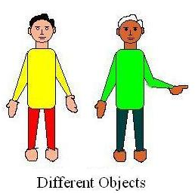
Class & Objects …
Class :
Attributes:
Hair, eyes, face, Neck,
torso, hands, legs.
Fingers, height, weight,
age.
Methods:
walk(), talk(), point(),
Laugh(), cry(), dance(),
steady()
[Definition of Class Man]

Slide 6
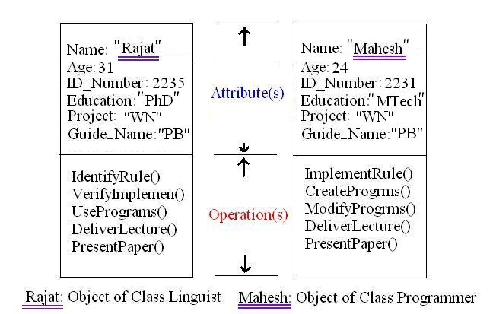
Object & Class …
nlp-ai@cse.iitb

Slide 7
Method Examples
void hello(String guest){//not returning anything
System.out.println(“Oh! Hello ” + guest);
}
int ReturnSquare (int a_number){//returning data of type int
int square = a_number * a_number;
return square;
}
double give_pi_value(){// no parameters are needed
return 3.1428571428;
}
nlp-ai@cse.iitb

Slide 8
String Class
String is a very special class in Java.
Strings are constants, their values cannot be changed after they are created. But they can be reinitialize.
String here=“I am here”;
here=“I am there”;//previous one is completely deleted
Our rules and dictionaries can be stored string class.
This class is armed with useful methods….
compareTo(String str), concate(String str), endsWith(String str),
indexOf(int ch), length(), startsWith(String str),
lastIndexOf(String str).
nlp-ai@cse.iitb

Slide 9
String Class…
String machine = “pentium”;
int comp = machine.compareTo(“pentium”); //comp=0;
String lab= “Language”;
lab=lab.concate(“ Technology”); //lab=“Language Technology”;
int ind = machine.indexOf(‘t’);//ind = 3;
boolean start = machine.startsWith(“pen”); //true
boolean end = machine.endsWith(“um”); //true
String part1=machine.substring(0,3); //part1=“pen”;
String part2=machine.substring(5);//part2=“um”;
int len=machine.length(); // len = 7;

Slide 10
Problem 1
Prob1: Judge the string whether it denotes valid number .
str1 = “124”; // function must return true
str2 = “421lakhan”; // function must return false
Method :
Scan each and every character of given string
for (i = 0; i < str.length(); i + +) {//scanning loop
char ch = str.indexOf(i);
switch( ch ){
case 0:response = true; break; // break to avoid further checking
:
case 9:response = true; break;
default: response = false;
}
if (response = = false) come out of the for loop;
} return response;
Refer reg.java
nlp-ai@cse.iitb

Slide 11
Problem 2
Prob1: Count and print the tokens in the string (separated by spaces).
str1 = “sa re ga ma pa”; // 5 tokens
str2 = “ ”; // zero token
str3 = “ reference ”; // single token
Method :
LOOP till the string finishes:
Step 1: Search for first non space char till the string
finishes (startIndOfToken)
Step 2: Increase the index to the next character.
Step 3: Search for first space character.(lastIndOfToken)
Step 4: Increase the total number of tokens by one.
Refer tokenize.java
nlp-ai@cse.iitb

Slide 12
Problem 3
Prob1: Solve Problem 2 and then search whether a string is present or not.
str1 = “I am writing a problem”; // 5 tokens
obj.isThisStringPresent(“am”);// should return true
Method :
Step 1: Use problem two to extract tokens.
Step 2: Store them into an String array.
Step 3: While searching, scan the whole array.
Refer search.java
nlp-ai@cse.iitb

Slide 13
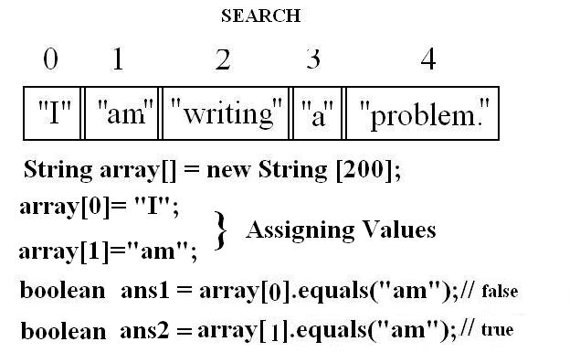
Problem 3 …..
nlp-ai@cse.iitb

Slide 14
Problem 4
Prob1: Solve Problem 3 and then show all unique tokens followed by their frequency in the given string.
str1 = “I am here . I am there .”; // 8 tokens
Example: I 2
am 2
here 1
. 2
there 1
Method :
Step 1: Use problem three to search tokens.
Step 2: When a token is found, check whether is present.
if it is present increase its freq by one
else add as new token
Refer freq.java
nlp-ai@cse.iitb

Slide 15
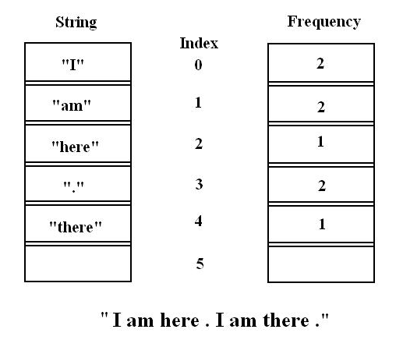
Problem 4 ……
nlp-ai@cse.iitb

Slide 16
Assignments
Mention your own class with some attributes & methods (do not implement).
Enhance reg.java’s code to accept a string only of characters from A to Z. (all in Upper case.)
(reg.java is provided in the code folder.)
Example:
AHCD is accepted.
A3HCD is rejected.
43534 is rejected.
nlp-ai@cse.iitb

Slide 17
End
Thank You!
nlp-ai@cse.iitb

